Slide 1
MACHINE LEARNING · INFOSYS SPRINGBOARD
Smart Failure Detection
Using Machine Learning
Predictive Maintenance & Real-Time Anomaly Detection for Industrial Systems
Infosys Springboard Virtual Internship 7.0
1
Aadya Patil
Balasri Korasikha
3
Bandaru Keerthi Pranathi
Chandini K
Vasavi Kolla
2
4
5

Slide 2
PROBLEM STATEMENT
Challenges with Traditional Failure Detection
Traditional maintenance approaches rely heavily on manual monitoring and fixed thresholds, making it difficult to identify early failure patterns from multiple machine parameters.
1
Reactive Maintenance
2
Fixed Threshold Limitations
Machines are often inspected or repaired only after a failure occurs, resulting in unexpected downtime, production losses, and higher maintenance costs.
Simple threshold-based monitoring may not capture complex relationships between temperature, rotational speed, torque, and tool wear.
3
Lack of Predictive Capability
4
Multiple Sensor Parameters
Traditional monitoring cannot effectively learn patterns from historical sensor data to predict whether a machine is likely to fail.
Monitoring several machine parameters manually makes it difficult to identify combinations of conditions that may indicate an upcoming failure.

Slide 3
PROPOSED SOLUTION
ML-Powered Predictive Maintenance System
Our proposed system uses machine learning on historical machine sensor data to predict potential failures and provide machine health insights and maintenance recommendations.
AI
MS
RH
MR
Machine Failure Prediction
Multi-Sensor Analysis
Risk & Health Assessment
Maintenance Recommendation
A Random Forest Classifier analyzes machine sensor data and predicts whether the machine is likely to experience a failure.
The prediction is converted into a failure probability and machine health score, allowing the machine condition to be classified as low, medium, or high risk.
Based on the predicted risk level, the system provides maintenance recommendations to help operators take appropriate preventive action.
The system analyzes machine type, air temperature, process temperature, rotational speed, torque, and tool wear to identify failure patterns.
Flow: Sensor Data → Preprocessing → Random Forest → Failure Prediction → Health & Risk Assessment → Maintenance Recommendation

Slide 4
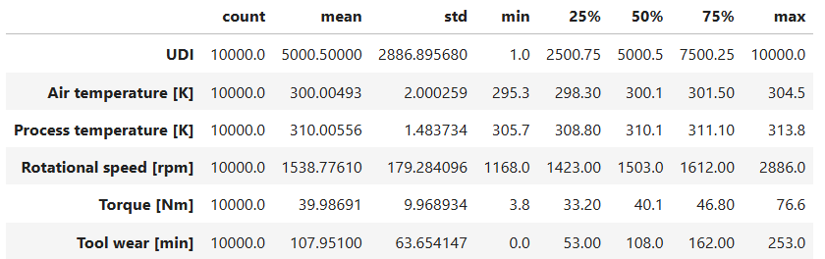
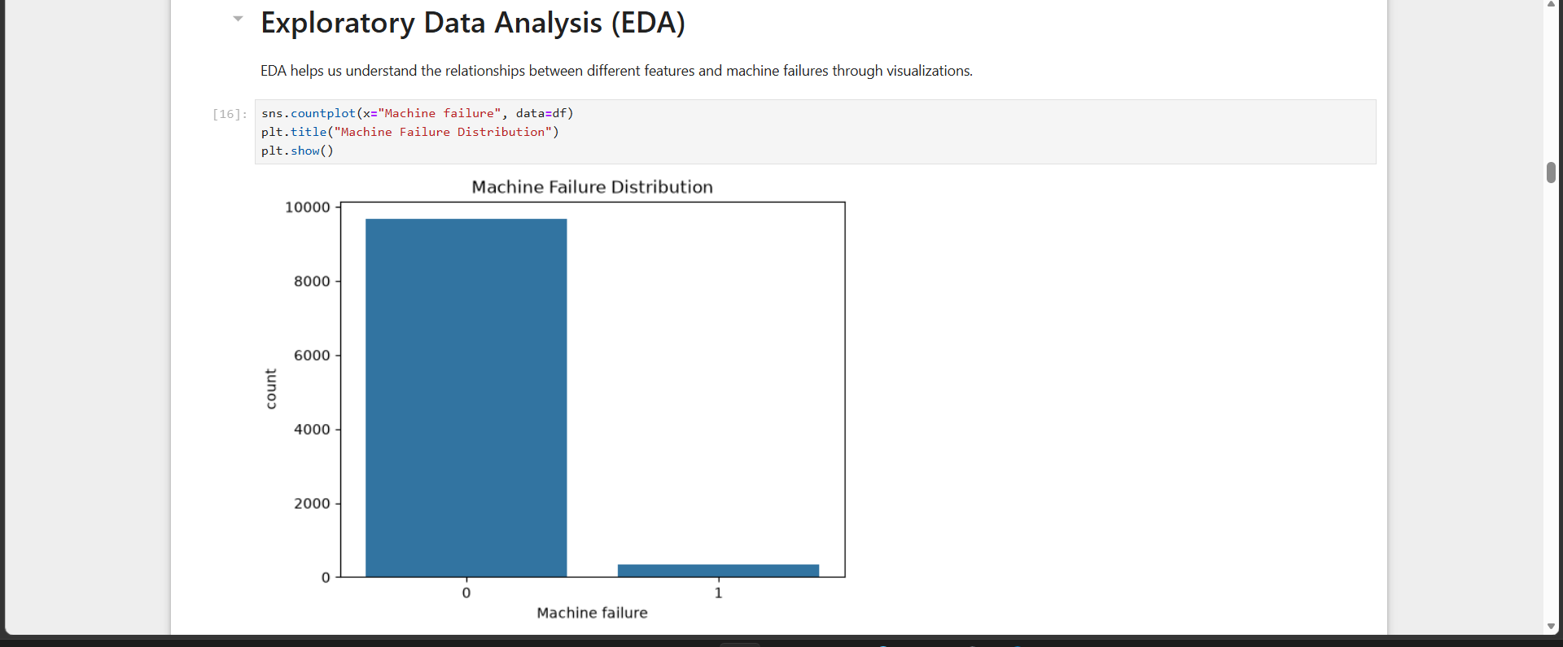
DATASET
Dataset Used – AI4I 2020 Predictive Maintenance Dataset
We use the AI4I 2020 Predictive Maintenance Dataset, a publicly available industrial dataset designed for predictive maintenance and machine failure detection. It contains 10,000 machine observations with realistic sensor readings, suitable for training ML models to identify failures before they occur.
1
Input Features
2
Target Variable
• Air Temperature (K)
• Process Temperature (K)
• Rotational Speed (RPM)
• Torque (Nm)
• Tool Wear (Minutes)
• Machine Type (Low, Medium, High)
• Machine Failure
0 = No Failure
1 = Failure
3
Failure Types
4
Why We Chose
This Dataset
• Tool Wear Failure (TWF)
• Heat Dissipation Failure (HDF)
• Power Failure (PWF)
• Overstrain Failure (OSF)
• Random Failure (RNF)
• Specifically designed for predictive maintenance
• Contains realistic industrial sensor data
• Includes multiple failure conditons
• Ideal for building and evaluating ML models

Slide 5
WORKFLOW
System Workflow: End-to-End Predictive Maintenance
The smart failure detection pipeline follows a structured, automated workflow, from raw data ingestion all the way to alert generation and feedback-driven model improvement.
1
Data Collection & Dataset Preparation
We use the AI4I 2020 Predictive Maintenance Dataset containing 10,000 machine records with parameters such as temperature, rotational speed, torque, tool wear, and machine type.
2
Data Preprocessing & Feature Engineering
The dataset is cleaned and prepared by handling data inconsistencies, converting machine type into numerical values, selecting relevant features, splitting the data into training and testing sets, and applying StandardScaler.
3
Machine Learning Model Training
Different supervised machine-learning approaches are evaluated, and the Random Forest Classifier is used as the final model to learn patterns between machine parameters and failure conditions. The trained model and scaler are saved using Joblib.
4
Failure Prediction & Dashboard
The trained model takes machine sensor inputs through the Streamlit dashboard and predicts normal or failure conditions. It also displays the failure probability, machine health score, risk level, and maintenance recommendation, while storing prediction results in the history.

Slide 6
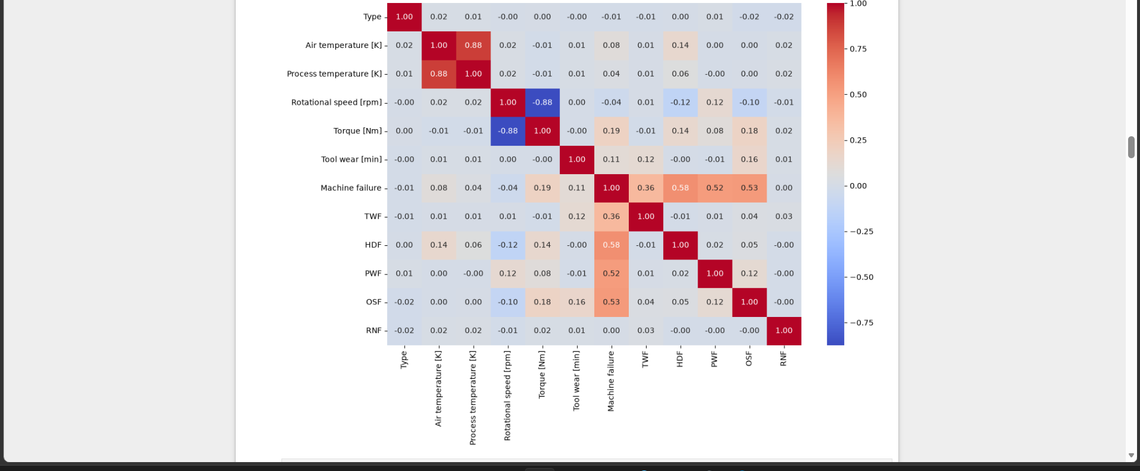
DATA PREPROCESSING
Preparing Data for Reliable Model Training
Clean, well-structured data is the foundation of every accurate prediction.
Correlation Matrix
1
Missing Value Treatment
The dataset was checked for missing, null, and inconsistent values to ensure the data was complete and reliable before model training..
2
Categorical Encoding
The Machine Type feature containing L, M, and H categories was converted into numerical values so that it could be processed by the machine-learning model.
3
Feature Selection
Relevant machine parameters such as temperature, rotational speed, torque, and tool wear were selected based on their usefulness in predicting machine failure.
4
Train-Test Split
The prepared dataset was divided into training and testing sets so that the model could learn from one portion of the data and be evaluated on unseen data.
5
Feature Scaling
StandardScaler was applied to normalize the numerical feature values and put them on a comparable scale before passing them to the machine-learning model.

Slide 7
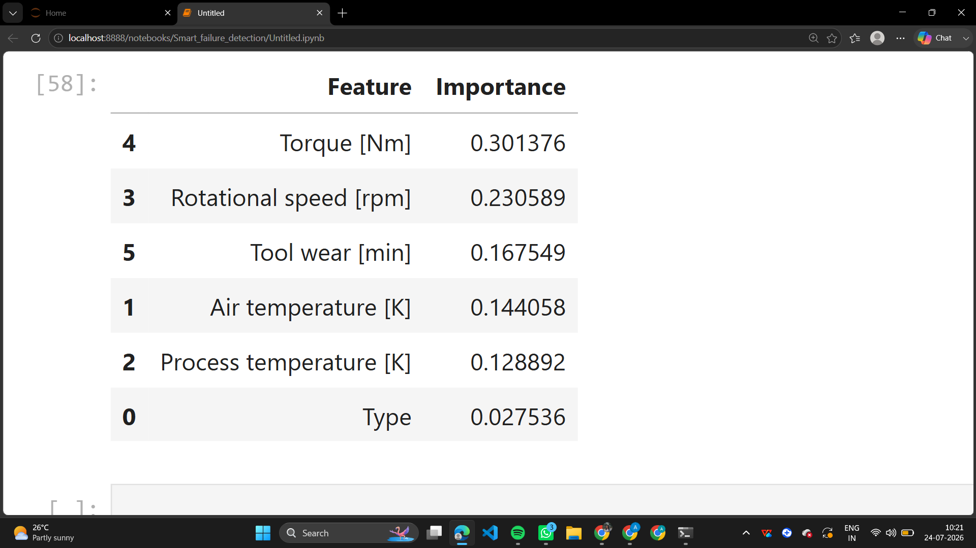
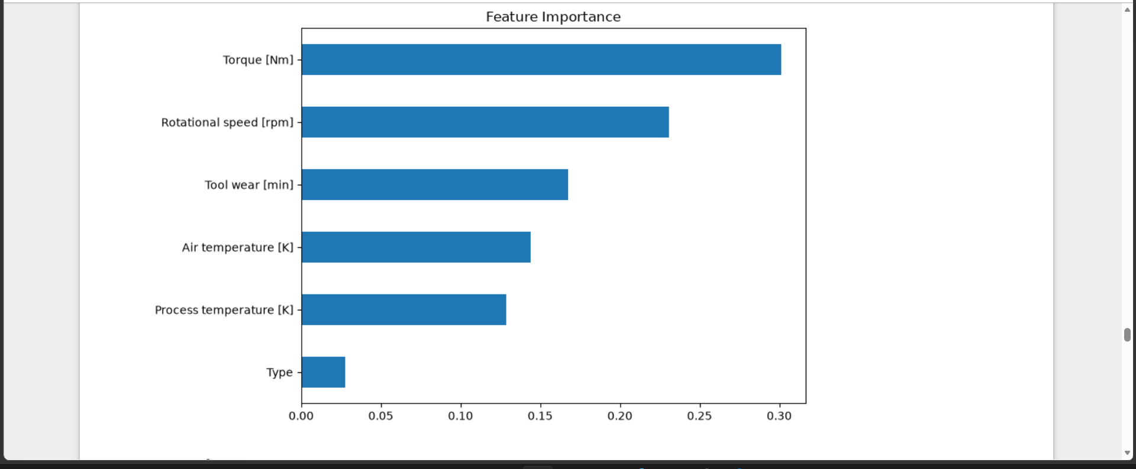
MACHINE LEARNING MODELS
Comparing Models to Find the Best Predictor
Multiple classification models were trained and compared using their predictive performance, with Random Forest selected as the final model.
Logistic Regression
97.30%
Accuracy
Decision Tree
97.85%
Accuracy
Random Forest
98.40%
✓ SELECTED
SVM
97.70%
Accuracy

Slide 8
TECHNOLOGY STACK
Tools & Technologies Used
The system is built on industry-standard open-source and cloud-native technologies, ensuring scalability, reliability, and ease of integration with existing enterprise infrastructure.
DATA & ML INFRASTRUCTURE
DASHBOARD & VISUALIZTION
Python & Pandas
Streamlit
Used for data loading, cleaning, preprocessing, feature preparation, and dataset analysis.
Used to build the interactive web dashboard for machine failure prediction, analytics, and prediction history.
Numpy & Scikit-learn
Plotly
Used for numerical operations, data preprocessing, model training, evaluation, and classification.
Used to create interactive charts such as scatter plots, gauges, bar charts, pie charts, box plots, and correlation matrices.
Random Forest & Joblib
CSV & Jupyter Notebook
Random Forest is the final prediction model, while Joblib is used to save and load the trained model and scaler.
CSV files are used for dataset and prediction-history storage, while Jupyter Notebook was used for model development and experimentation.

Slide 9
SAMPLE PREDICTIONS
From Raw Sensor Data to Actionable Health Insights
Two live examples showing how the model turns sensor readings into a health score, failure probability, and a recommended action.
NORMAL OPERATION
CRITICAL — ATTENTION NEEDED
Machine #A-104 — Healthy
Machine #C-217 — High Risk
Machine Health Score
96%
Machine Health Score
14%
Failure Probability
4%
Failure Probability
86%
KEY SENSOR SIGNALS
KEY SENSOR SIGNALS
Torque 42 Nm · Rotational Speed 1,510 rpm · Tool Wear 38 min
Torque 61 Nm · Rotational Speed 2,340 rpm · Tool Wear 214 min
RECOMMENDED ACTION
RECOMMENDED ACTION
Continue standard monitoring schedule — no action needed at this time.
Self-healing action: reduce load, inspect tool insert, and schedule immediate maintenance.

Slide 10
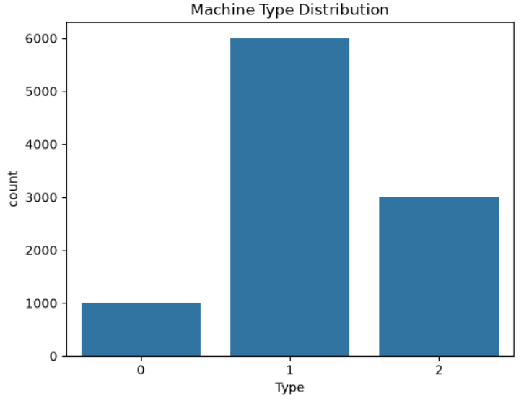
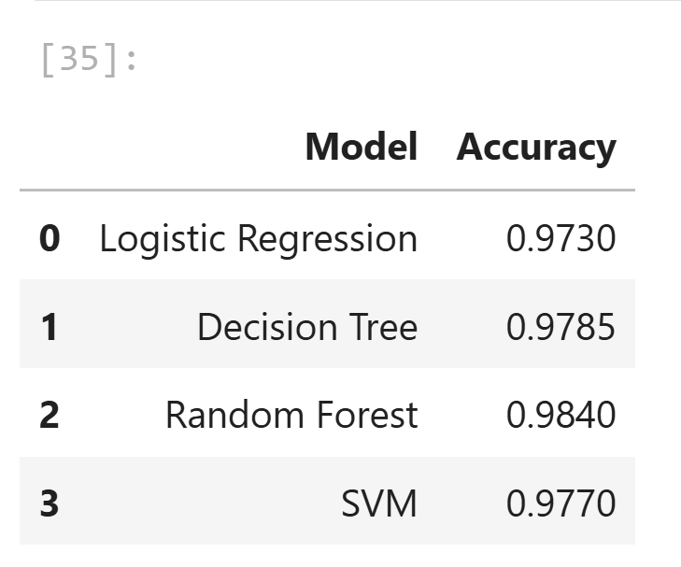
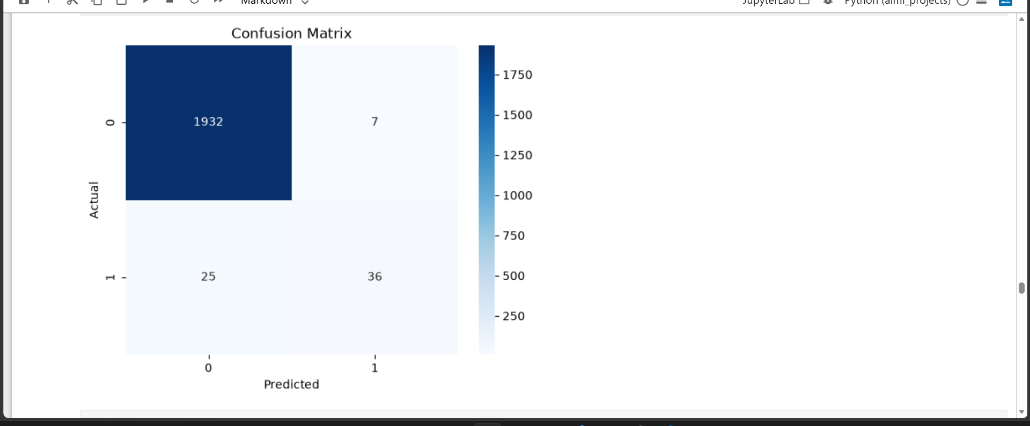
RESULTS
Random Forest Delivers the Strongest Performance
Model Accuracy Comparison
Confusion Matrix — Random Forest
KEY FINDINGS
Random Forest achieved the highest accuracy at 98.40% among all models tested.
Only 7 false alarms and 25 missed failures out of ~2,000 test cases.
Torque and Rotational Speed emerged as the strongest failure predictors.
Model maintains high recall on the rare failure class despite class imbalance.
Consistent performance across all five failure modes (TWF, HDF, PWF, OSF, RNF).
Selected as the production model for real-time health scoring.

Slide 11
BENEFITS
Key Benefits of Smart Failure Detection
Adopting an ML-driven failure detection system delivers measurable improvements across operational efficiency, cost management, safety, and system reliability for organizations of all sizes.
↓
↓
↑
↑
Downtime
Costs
Accuracy
5x Faster
Unplanned Downtime
Maintenance Costs
Detection Accuracy
Incident Response
Early anomaly detection lets teams address issues before failures occur, cutting unexpected outages.
Predictive maintenance eliminates unnecessary cycles and reduces emergency repair expenses.
ML models outperform threshold-based systems, catching complex multivariate failure patterns.
Automated smart alerts with root-cause context resolve issues up to 5x faster than manual monitoring.

Slide 12
FUTURE SCOPE
Scaling Toward a Fully Autonomous Maintenance System
The current model is the foundation for a production-grade, always-on predictive maintenance platform.
1
Streamlit Dashboard
2
IoT Integration
An interactive web app for live machine health monitoring, accessible to plant operators and managers.
Stream real sensor data directly from edge devices and PLCs for true real-time predictions.
3
Cloud Deployment
4
Real-Time Monitoring & Alerts
Host the model on scalable cloud infrastructure (AWS / Azure) to support multiple plants.
Push live anomaly alerts to maintenance teams via SMS / email the moment risk is detected.

Slide 13

CONCLUSION
Toward Smarter, Self-Healing Manufacturing
This project demonstrates that AI can move beyond simple failure prediction by combining accurate classification, continuous health scoring, and prescriptive self-healing guidance into a single intelligent system for smart manufacturing.
1
2
3
Proven Predictive Power
Actionable Health Insights
Foundation for Industry 4.0
Random Forest achieved 98.4% accuracy , reliably classifying failures from real sensor data.
Health scores, failure probability, and self-healing recommendations go beyond a simple Yes/No prediction.
A scalable architecture, ready for IoT streaming and cloud deployment across multiple plants.

Slide 14
Thank You
Presented By:
Aadya Patil
Balasri Korasikha
Bandaru Keerthi Pranathi
Chandini K
Vasavi Kolla

